Slide 1
Modeling Terminology for Chemical Safety
Leah McEwen
VoCamp, University of Maryland
2016.11.29

Slide 2
Stakeholders
Bench chemists performing procedures
Direct users of hazardous chemicals
Neighbors of hazardous processes
Lab supervisors with direct legal responsibility
Lab group leaders
Core facility managers
Institutional and public bodies that support laboratory science
Facility designers and operators
Safety service providers, including emergency planning and response and waste disposal staff, usually associated with EHS departments and regulators
OSP Liaisons with community and granting agency
The larger scientific community
Use of Lessons Learned
Public confidence to support funding of lab sciences
Notes:
Would like to anticipate the threats and consequences for exposure to the hazards of a given substance or group of substances and relate these to different control options
Goal is successful experiment and minimization of exposure
Exposure happens with loss of control leading to an adverse outcome
Exposure potential = inherent hazard X local risk (likelihood)
Minimize exposure by mitigating threats and consequences
Mitigate threats by monitoring and controlling conditions

Slide 3
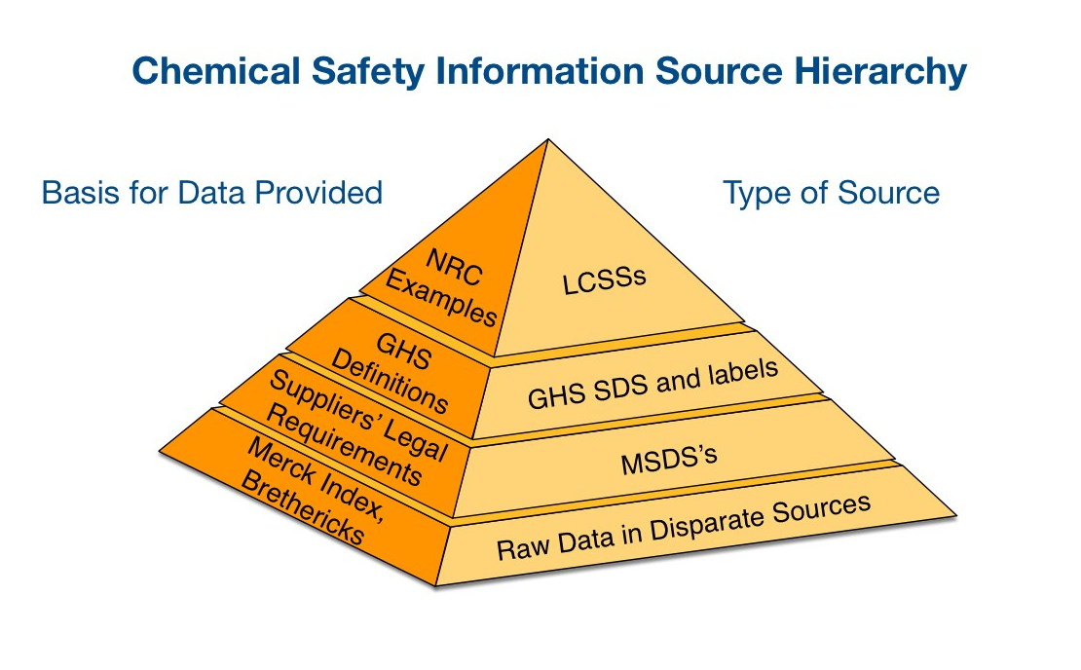
The Evolution of Chemical Safety Information
Increasingly user-specific and well-defined; also increasing voluminous
1990's
2000's
1980's
1970's
GHS might serve as a periodic table style ontology by organizing recognized chemical hazards into coherent groups, but needs to be connected to the existing chemical safety corpus to realize this oppotunity

Slide 4
Model Mitigation Controls from Reported Incidents
Notes:
Would like to anticipate the threats and consequences for exposure to the hazards of a given substance or group of substances and relate these to different control options
Goal is successful experiment and minimization of exposure
Exposure happens with loss of control leading to an adverse outcome
Exposure potential = inherent hazard X local risk (likelihood)
Minimize exposure by mitigating threats and consequences
Mitigate threats by monitoring and controlling conditions

Slide 5
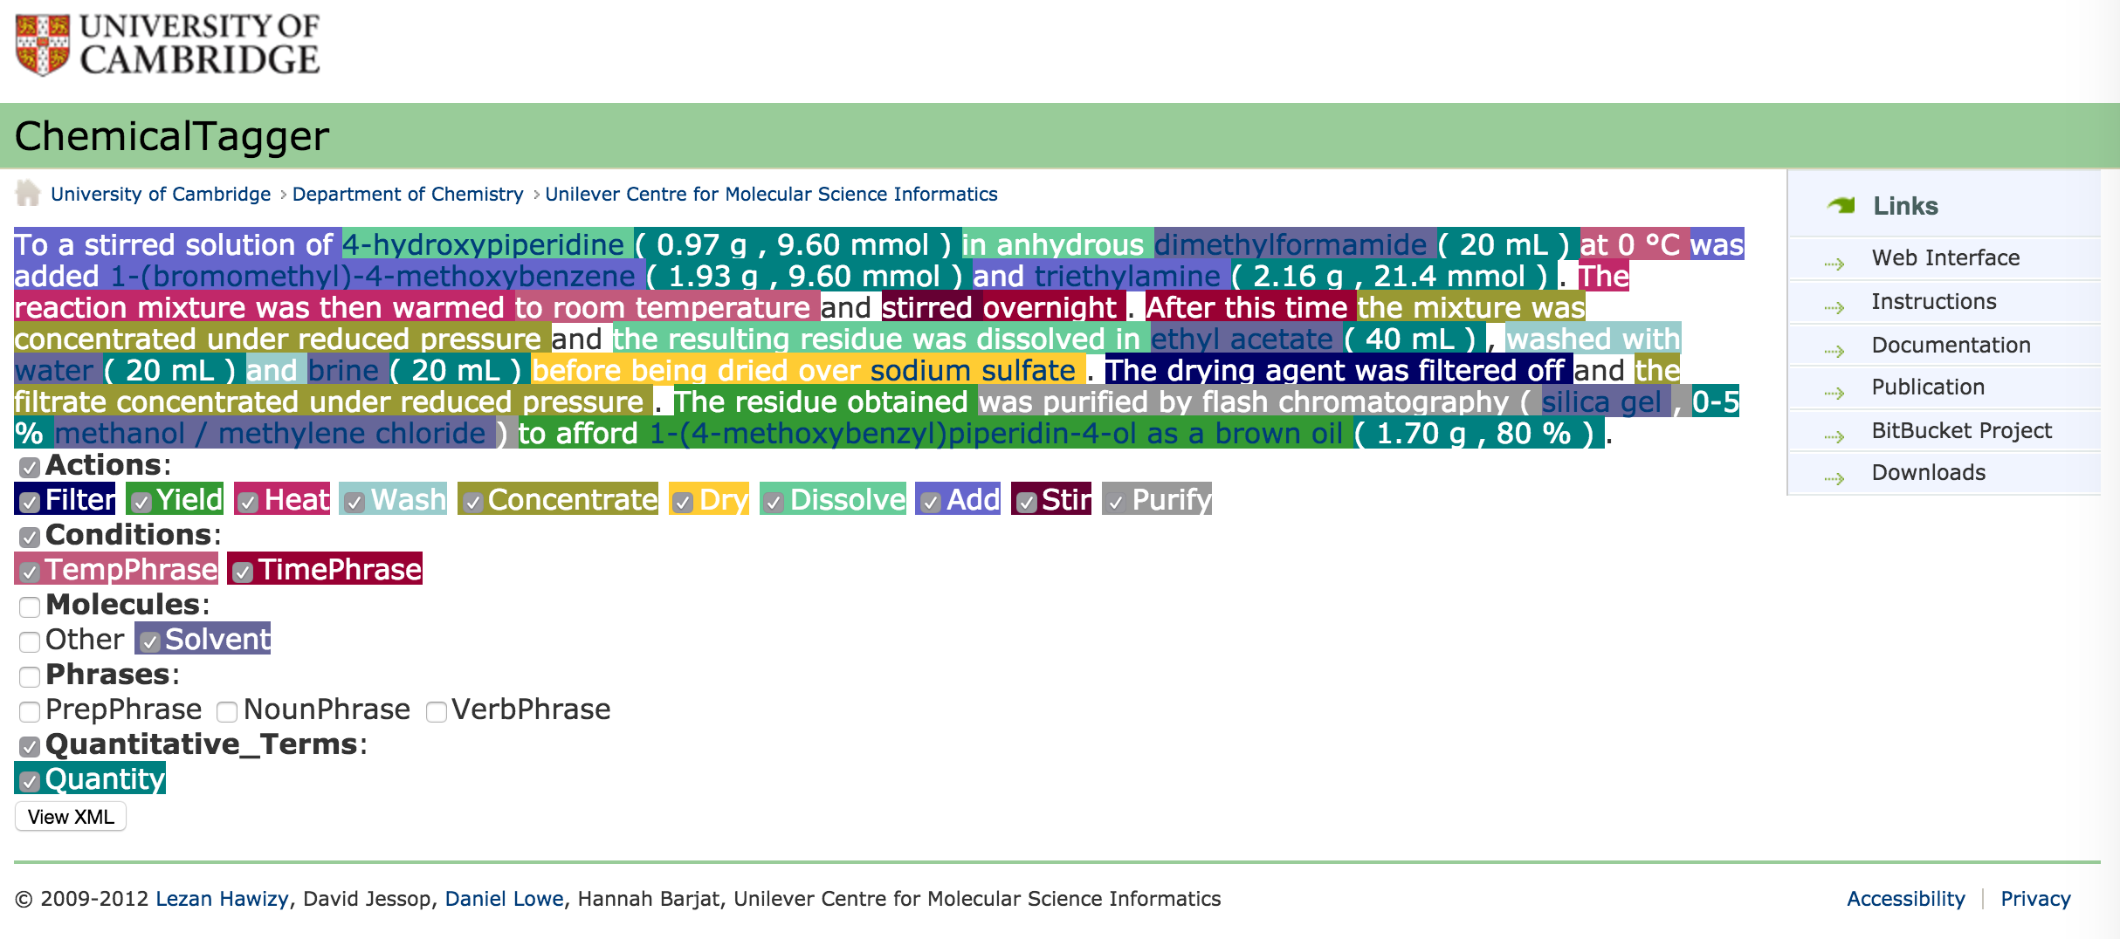
Analyze Experimental Procedures for Conditions of Potential Threats
Notes:
Would like to anticipate relationships among substances, conditions and process that could lead to threats and consequences for exposure to hazards
Goal is successful experiment and minimization of exposure
Exposure happens with loss of control leading to an adverse outcome
Exposure potential = inherent hazard X local risk (likelihood)
Minimize exposure by mitigating threats and consequences
Mitigate threats by monitoring and controlling conditions

Slide 6
Project Goals
Framework with richer metadata using standard terms that are semantically expressed in RDF
Support competency queries needed in domain risk assessment
Focus on substance relationship to outcomes and various conditions and process variables.
* First time focusing on these together

Slide 7
Existing Safety Vocabularies (sample)
(M)SDS Hyperglossary http://www.ilpi.com/msds/ref/flammableaerosol.html0
ILO Occupational Safety and Health terminology http://www.ilo.org/dyn/oshthes2/en/f?p=OSHTHES2:1:0::NO:::
ICPS Glossary from UN/ILO/WHO http://www.ilo.org/legacy/english/protection/safework/cis/products/safetytm/glossary.htm
OECD SIDS for high production volume chemicals http://www.inchem.org/pages/sids.html
WHO http://www.inchem.org/pages/harmproj.html
Notes:
(M)SDS – key terms in common documentation (SDS), many linked relationships among terms
ILO – exposure
OECD - chemical?

Slide 8
Data from Reported Incident Strings
Arsine, phosphine, and tetraborane are all oxidized explosively by fuming nitric acid.
Phosphine, hydrogen sulfide, and selenide all ignite when fuming nitric acid is dripped into the gas.
Hydrogen telluride ignites with cold concentrated nitric acid, sometimes exploding.
Substances
Outcomes
Consequences
Conditions
Operations
Apparatus/ equipment
https://pubchem.ncbi.nlm.nih.gov/compound/nitric_acid
Notes:
[Source: Bretherick, L. Handbook of Reactive Chemical Hazards. 4th ed. Boston, MA: Butterworth-Heinemann Ltd., 1990, p. 1171; Compiled by TOXNET HSDB, NLM]
[primary data set includes incident strings described in Brethericks, reproduced in PubChem (courtesy of HSDB), and Pistoia CSL data]
[describes some similar process factors that govern experiments, so should be able to use connections modeled from incidents to identify potential problem patterns in planned experimental procedures]

Slide 9
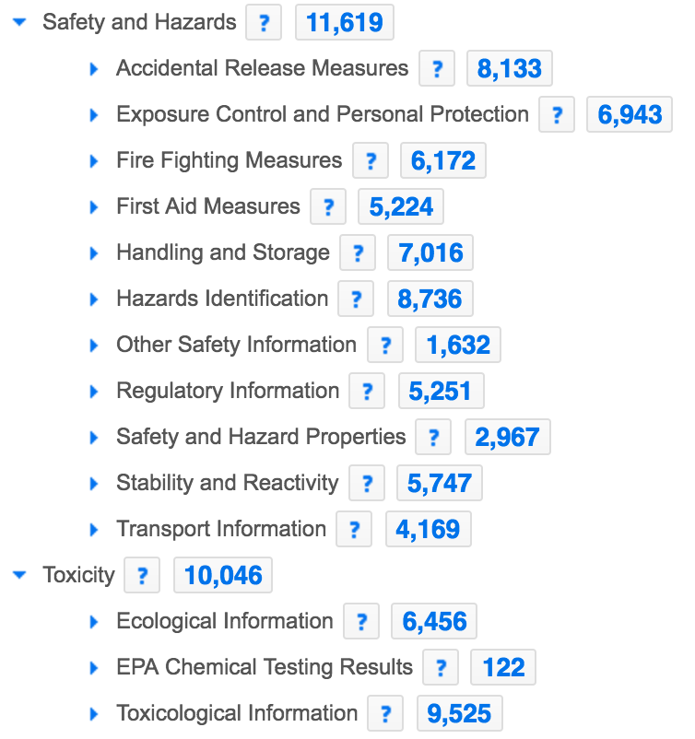
Safety Term Histograms (PubChem)
PubChem Compound TOC Tree
Explosion Prevention
‘electrical equipment and’ 358
‘closed system, ventilation’ 340 (167)
’above [[number]] degrees’ 289
Reactivities and Incompatibilities
‘with [[number + symbol]] water’ 437
‘[[number]] deg C’ 268
‘contact with’ 260 (232)
Exposure Routes
‘skin’ 1361 (67)
’ingestion’ 1068 (517)
‘inhalation’ 911 (848, 181)

Slide 10
Chemical Safety Queries
What substances meet a given set of criteria for hazard properties?
What is the consequence of exposing one particular substance to another under a particular condition?
What conditions and tasks are associated with hazardous events for a given set of substances?
What are the exposure routes of substances used or generated and what controls protect these routes?
What mitigation strategies could be used to ameliorate the effect of exposure to a particular hazard?
*based on ACS CCS Safety Advisory Panel, 2016
Notes:
Michelle | great complementary work, right side of the bowtie, also of interest in risk assessment:
What is the consequence of exposing a particular object to a particular hazard for a particular amount of time?– What are the hazards to a particular object at a particular geographic location?– What hazards are capable of causing a given consequence?– What susceptibilities could result in negative consequences to an object exposed to a particular hazard?– What mitigation strategies could be used to effect exposure to a particular hazard?

Slide 11
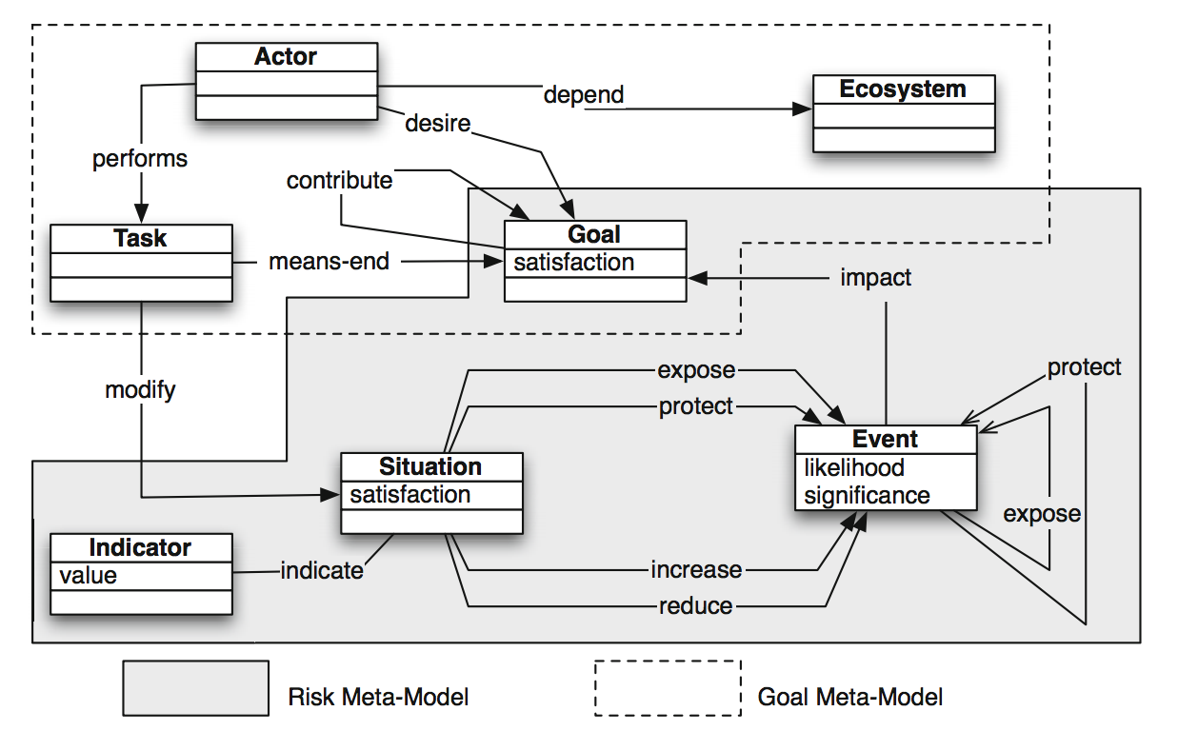
RiskML Risk Assessment Model
Siena et al. 2014

Slide 12
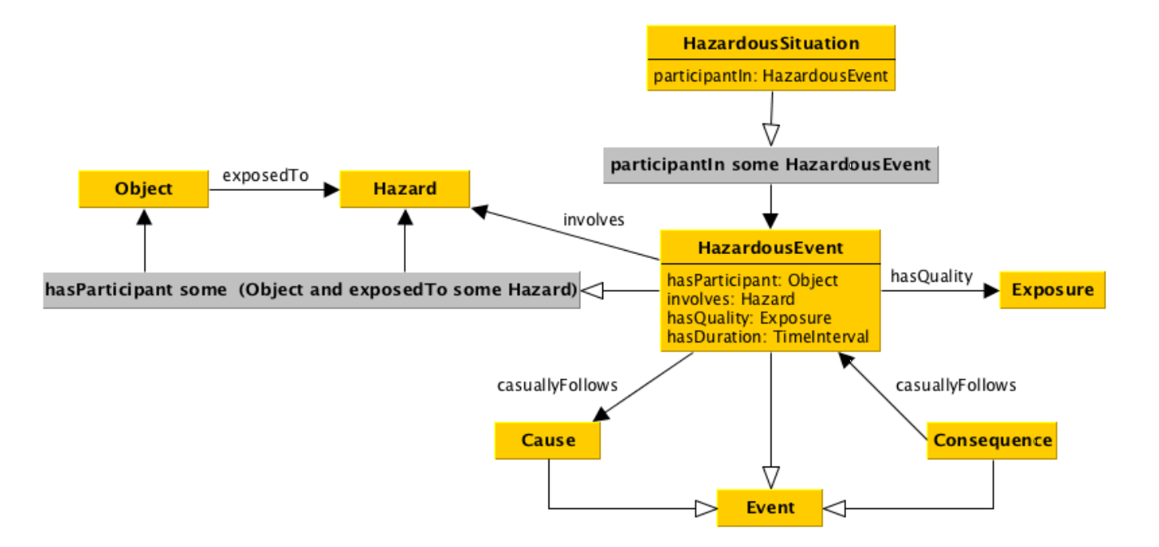
Hazardous Situation ODP
Lawrynowicz and Lawniczak. 2015
Notes:
Hazard & Risk ontology progression

Slide 13
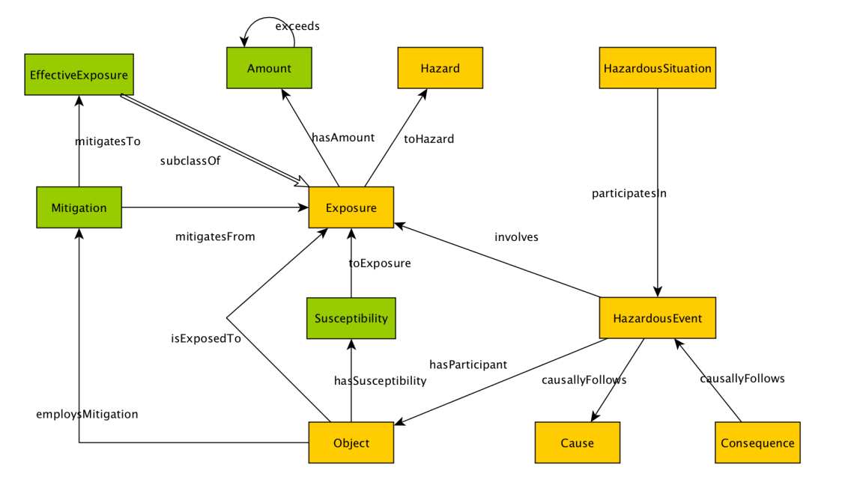
Modified Hazardous Situation ODP
Cheatham et al. unpublished

Slide 14
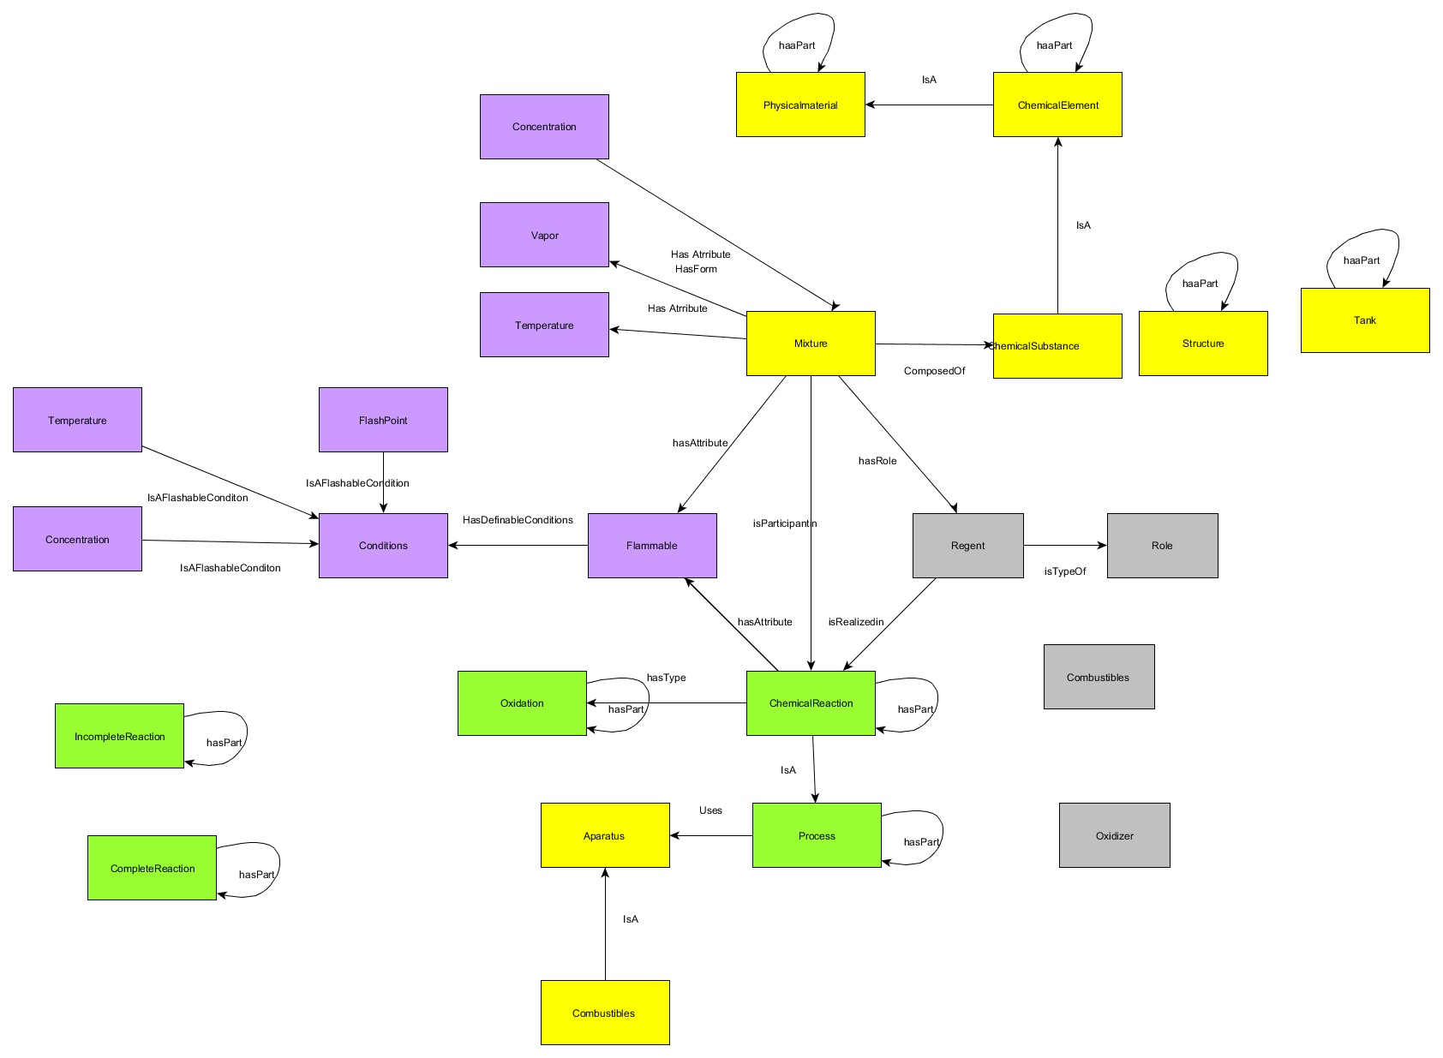
Modelling Mixtures
Notes:
“Ecosystem” of actors (substances), tasks (procedures), and conditions.
We want to query how these relate together in a given scenario
Example – mixture of multiple substances heated
[Worked example]

Slide 15
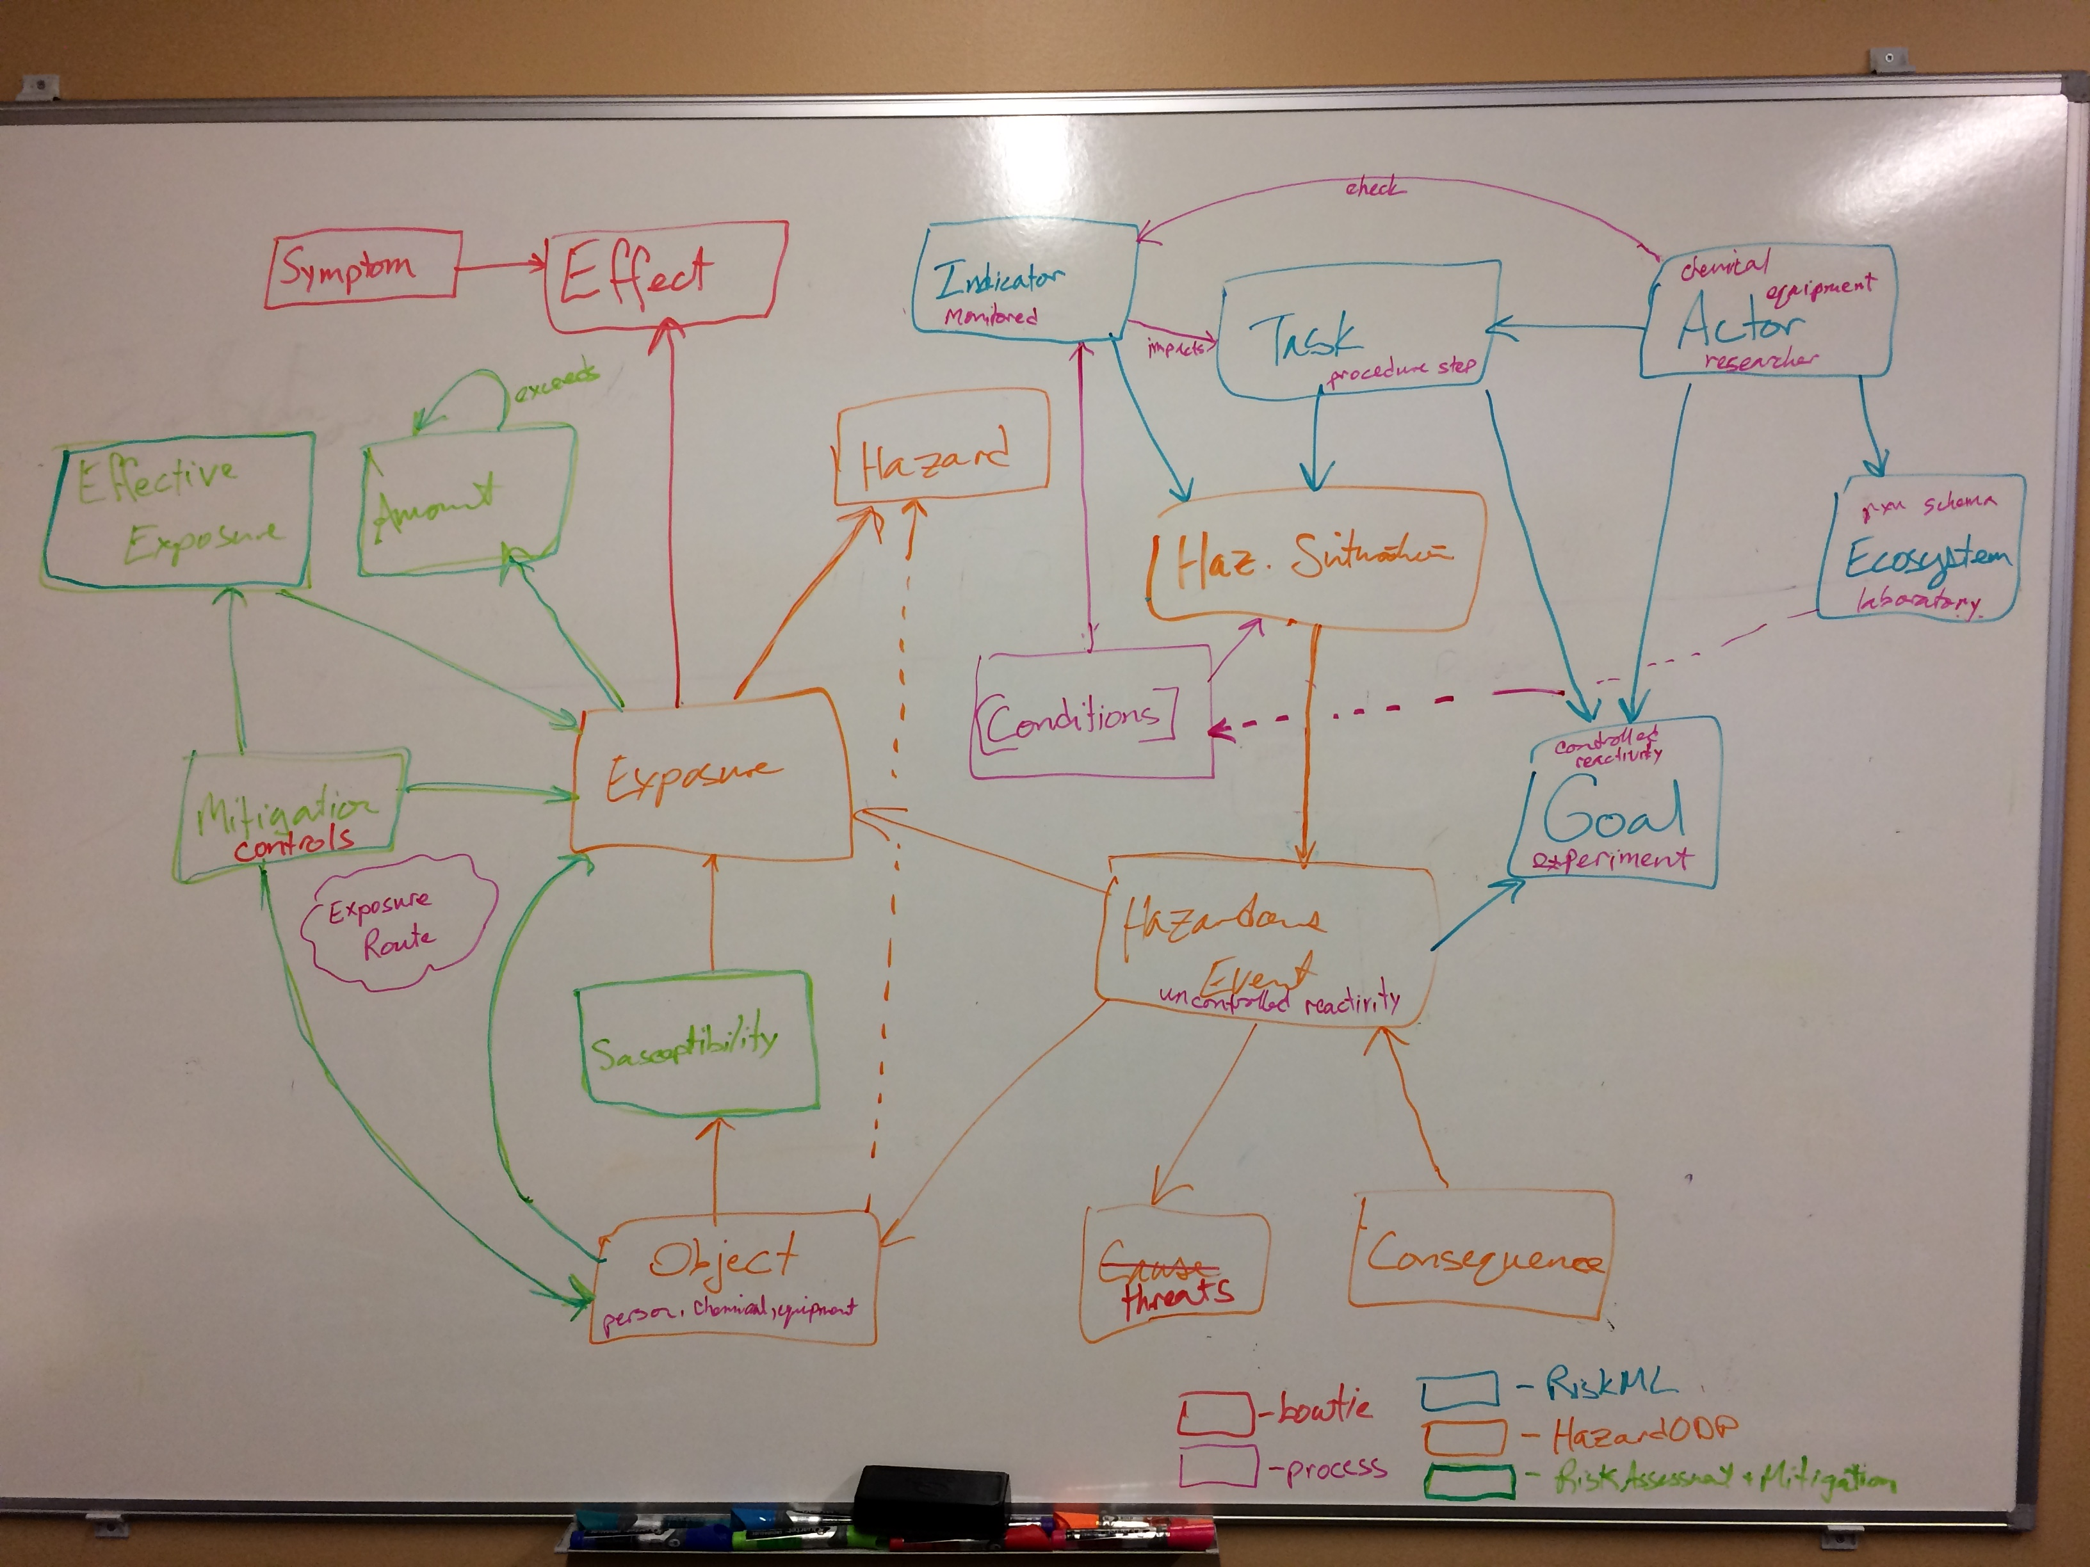
Putting it all together
“Ecosystem” of actors (substances), tasks (procedures), and conditions
We want to query how these relate together in a given scenario
Notes:
Are there experimental procedure ontologies that might cover roles of conditions / variables ? Importance of process
Ordered, with checkpoints
Planned
Risk of unplanned
Critical changes in conditions
some physical, managed by physical controls (e.g., equipment)
some chemical, managed by chemical controls (i.e., other chemicals)
Concept of mixtures
Attribute relationships are not necessarily consistent
Mixture is a change of condition for the components

Slide 16
Key Issues to Consider
Importance of process
Ordered, with checkpoints
Planned
Risk of unplanned
Critical changes in conditions
some physical, managed by physical controls (e.g., equipment)
some chemical, managed by chemical controls (i.e., other chemicals)
Concept of mixtures
Attribute relationships are not necessarily consistent
Mixture is a change of condition for the components

Slide 17
Project Scope
Modeling risk assessment process for chemical procedures in research laboratories
Terminology and relationships associating process conditions with hazards and exposure controls with consequences
First time focusing on change in conditions, upstream of hazardous events
First time distinctively articulating hazard attributes, exposure risk, mitigation controls, and emergency response
Building on exposure mitigation work started by Michelle Cheatham
Notes:
Michelle | great complementary work, right side of the bowtie, also of interest in risk assessment:
What is the consequence of exposing a particular object to a particular hazard for a particular amount of time?– What are the hazards to a particular object at a particular geographic location?– What hazards are capable of causing a given consequence?– What susceptibilities could result in negative consequences to an object exposed to a particular hazard?– What mitigation strategies could be used to effect exposure to a particular hazard?

Slide 18
Use cases
Support core questions in the risk assessment decision process
Conceptual analysis of research laboratory procedures
Identification of prevention and mitigation controls for multiple hazard types
Incident analysis including threats, consequences, and loss of control
Annotate collections of chemical incident data and other text-based information relevant to chemical health and safety

Slide 19
Questions for Chemical Lab Risk Assessment
What specific chemical and physical hazards are associated with a lab process?
What means (including elimination and substitution) are available to reduce or eliminate the hazard(s)?
Does this process require the use of engineering controls such as a fume hood, shields, etc.?
What PPE is appropriate?
What appropriate clean up and disposal protocols are required?
What are possible emergencies and procedures to plan for them?
ACS CCS Safety Advisory Panel, 2016
Notes:
Michelle | great complementary work, right side of the bowtie, also of interest in risk assessment:
What is the consequence of exposing a particular object to a particular hazard for a particular amount of time?– What are the hazards to a particular object at a particular geographic location?– What hazards are capable of causing a given consequence?– What susceptibilities could result in negative consequences to an object exposed to a particular hazard?– What mitigation strategies could be used to effect exposure to a particular hazard?

Slide 20
Questions for Chemical Lab Risk Assessment
What specific chemical and physical hazards are associated with a lab process?
What means (including elimination and substitution) are available to reduce or eliminate the hazard(s)?
Does this process require the use of engineering controls such as a fume hood, shields, etc.?
What PPE is appropriate?
What appropriate clean up and disposal protocols are required?
What are possible emergencies and procedures to plan for them?
What is the consequence of exposing one particular chemical to another under a particular condition?
What chemicals meet a given set of criteria for hazard properties?
What are the exposure routes of chemicals used or generated and what controls protect these routes?
What are the susceptibilities of different protection materials when exposed to chemicals used or generated?
What indicators suggest reduced likelihood of a particular hazard?
What mitigation strategies could be used to ameliorate the effect of exposure to a particular hazard?
ACS CCS Safety Advisory Panel, 2016
Notes:
Michelle | great complementary work, right side of the bowtie, also of interest in risk assessment:
What is the consequence of exposing a particular object to a particular hazard for a particular amount of time?– What are the hazards to a particular object at a particular geographic location?– What hazards are capable of causing a given consequence?– What susceptibilities could result in negative consequences to an object exposed to a particular hazard?– What mitigation strategies could be used to effect exposure to a particular hazard?

Slide 21
Model Process For Safety Assessment
RAMP: goal is to identify what and how to implement safety controls for a particular chemical scenario; four step process / two preliminary and two follow along
Recognizing Hazards – chemical disposition, process (and players)
Assessing Risk – connecting factors (dispositions + process + conditions)
Managing Controls – intentional, equipment, procedures
Preparing for Emergency – equipment, procedures, personnel

Slide 22
Selecting a Reference Point
RAMP assessment process applies to several levels:
Chemical reaction
Experimental procedure
Laboratory environment
Community infrastructure
This exercise will focus on the experimental procedure scenario
The model could well serve other levels

Slide 23
Relationships of Experimental Goals and Risks
Many models in chemical lab safety work that relate concepts
Goal is successful experiment and minimization of exposure
Exposure happens with loss of control leading to an adverse outcome
Exposure potential = inherent hazard X local risk (likelihood)
Minimize exposure by mitigating threats and consequences
Mitigate threats by monitoring and controlling conditions
Notes:
Hazard: the property of a substance or situation with the potential for creating damage
Risk: the likelihood of a specific effect within a specified period - complex function of probability, consequences and vulnerability
[much discussion relevant to safety planning could be said about planning for successful experiments]
[where does the language cross over to safety considerations]
[prevention and mitigation of adverse outcome = loss of control + consequences, derived from threats + hazard]
[corollary description of chemical experiment/process]

Slide 24
From Experiments to Safety
[much discussion relevant to safety planning could be said about planning for successful experiments]
[where does the language cross over to safety considerations]
[prevention and mitigation of adverse outcome = loss of control + consequences, derived from threats + hazard]
[corollary description of chemical experiment/process]

Slide 25
Proactive Safety Planning for Controls

Slide 26
Experimental Procedure Analysis for Threats

Slide 27
[Data from Incident Strings]
[primary data set includes incident strings described in Brethericks, reproduced in PubChem (courtesy of HSDB), and Pistoia CSL data]
[describes some similar process factors that govern experiments, so should be able to use connections modeled from incidents to identify potential problem patterns in planned experimental procedures]

Slide 28
[Data Analysis Ongoing]
[UCal pilot]
[PubChem tritograms]
[Ahmed mining?]

Slide 29
Existing Safety Vocabularies
(M)SDS Hyperglossary http://www.ilpi.com/msds/ref/flammableaerosol.html0
ILO Occupational Safety and Health terminology http://www.ilo.org/dyn/oshthes2/en/f?p=OSHTHES2:1:0::NO:::
ICPS Glossary from UN/ILO/WHO http://www.ilo.org/legacy/english/protection/safework/cis/products/safetytm/glossary.htm
OECD SIDS for high production volume chemicals http://www.inchem.org/pages/sids.html
WHO http://www.inchem.org/pages/harmproj.html
Notes:
ILO – exposure

Slide 30
Hazardous Situation ODP
Lawrynowicz and Lawniczak. 2015
Notes:
Hazard & Risk ontology progression

Slide 31
Modified Hazardous Situation ODP
Cheatham et al. unpublished

Slide 32
RiskML Risk Assessment Model
Siena et al. 2014

Slide 33
Putting it all together
* Are there experimental procedure ontologies that might cover roles of conditions / variables and factoring in ecosystem?
Notes:
* Are there experimental procedure ontologies that might cover roles of conditions / variables ?

Slide 34
Modelling Mixtures

Slide 35
Importance of Process
[ordered actions, separated by ’check’ points – did medium reach new conditions adequately as desired?]
[co-temporal conditions, process controls changes in conditions]
[planned process, potential for ‘runaway’ process]

Slide 36
Conditions Critical
[key to identify change of condition for both intentional and potential runaway processes – time, nature, cause, participants]
[some conditions physical (temp, pressure, scale), some chemical (stoichiometry, humidity, inert atmosphere)
[physical conditions managed by equipment, apparatus]
[chemical conditions managed by other chemicals]

Slide 37
Concept of Mixtures
[1 | 2 NOT equal 3, or 2, or 1]
[mixing chemicals changes local chemical environment of each, change of condition, hard to predict, some taxonomy efforts]
[air components, including water, overlooked components; also residues]

Slide 38
Next steps – goals after VoCamp
Mining dictionary for analyzing procedures and incident reports
Testing for model, informatics and safety domain
Domain experts reviewing and contributing concepts
Incorporating more formal terms (reference official sources)
Design workflows that incorporate the terminology into RAMP processes and education

Slide 39
